Slide 1

Unit Testing
Building Rock-Solid Software
SoftUni Team
Technical Trainers
Software University
https://softuni.bg

Slide 2

Table of Contents
Seven Testing Principles
What Is Unit Testing?
Unit Testing Frameworks - JUnit
3A Pattern
Best Practices
Dependency Injection
Mocking and Mock Objects

Slide 3
Have a Question?
sli.do
#java-advanced

Slide 4
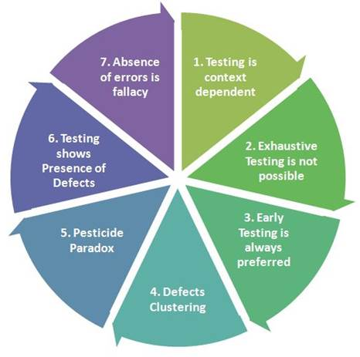
Seven Testing Principles

Slide 5
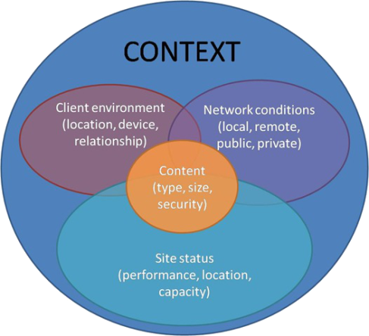
Seven Testing Principles (1)
Testing is context dependent
Testing is done differently in different contexts
Example:
Safety-critical software is tested differently from an e-commerce site
5

Slide 6
Seven Testing Principles (2)
Exhaustive testing is impossible
All combinations of inputs and preconditions are usually almost infinite number
Testing everything is not feasible
Except for trivial cases
Risk analysis and priorities should be used to focus testing efforts

Slide 7
Seven Testing Principles (3)
Defect clustering
Testing effort shall be focused proportionally
To the expected and later observed defect density of modules
A small number of modules usually contains most of the defects discovered
Responsible for most of the operational failures
Notes:
In your opinion which operation is most likely to cause your Operation system to fail?
- Opening Microsoft Word
- Open IE
- Opening 10 different application all at the same time

Slide 8
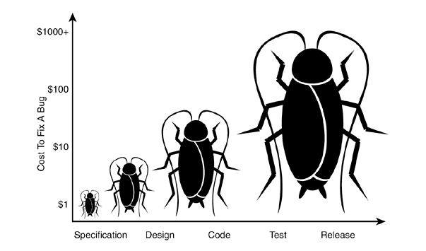
Seven Testing Principles (4)
Early testing is always preferred
Testing activities shall be started as early as possible
And shall be focused on defined objectives
The later a bug is found – the more it costs!

Slide 9
Seven Testing Principles (5)
Pesticide paradox
Same tests repeated over and over again tend to lose their effectiveness
Previously undetected defects remain undiscovered
New and modified test cases should be developed

Slide 10
Seven Testing Principles (6)
Testing shows presence of defects
Testing can show that defects are present
Cannot prove that there are no defects
Appropriate testing reduces the probability for defects

Slide 11
Seven Testing Principles (7)
Absence-of-errors fallacy
Finding and fixing defects itself does not help in these cases:
The system built is unusable
Does not fulfill the users needs and expectations

Slide 12

What is Unit Testing

Slide 13
Manual Testing (1)
Not structured
Not repeatable
Can't cover all of the code
Not as easy as it should be
void testSum() {
if (this.sum(1, 2) != 3) {
throw new Exception("1 + 2 != 3");
}
13

Slide 14
Manual Testing (2)
We need a structured approach that:
Allows refactoring
Reduces the cost of change
Decreases the number of defects in the code
Bonus:
Improves design

Slide 15
Automated Testing
System tests
Integration tests
Unit tests
The whole system
System
A single module
Integration
Unit
A single class

Slide 16

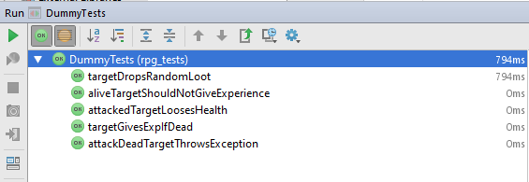
Junit (1)
The first popular unit testing framework
Most popular for Java development
Based on Java, written by Kent Beck & Co.

Slide 17
Junit (2)
Maven Repository – Junit 4.12
Copy JUnit repository and paste in pom.xml
<project …>
…
<dependencies>
<dependency>
<groupId>junit</groupId>
<artifactId>junit</artifactId>
<version>4.12</version>
<scope>test</scope>
</dependency>
</dependencies>
</project>

Slide 18
Junit – Writing Tests
Create new package (e.g. tests)
Create a class for test methods (e.g. BankAccountTests)
Create a public void method annotated with @Test
@Test
public void depositShouldAddMoney() {
/* magic */
}

Slide 19
3A Pattern
Arrange - Preconditions
Act - Test a single behavior
Assert - Postconditions
Each test should test a single behavior!
@Test
public void depositShouldAddMoney() {
BankAccount account = new BankAccount();
account.deposit(50);
Assert.assertTrue(account.getBalance() == 50)
}

Slide 20
Exceptions
Sometimes throwing an exception is the expected behavior
Assert
@Test(expected = IllegalArgumentException.class)
public void depositNegativeShouldNotAddMoney() {
BankAccount account = new BankAccount();
account.deposit(-50);
}
Arrange
Act

Slide 21

Problem: Test Axe
Create a Maven project
Add provided classes (Axe, Dummy, Hero) to project
In test/java folder, create a package rpg_tests
Create a class AxeTests
Create the following tests:
Test if weapon loses durability after attack
Test attacking with a broken weapon

Slide 22
Solution: Test Axe (1)
@Test
public void weaponLosesDurabilityAfterAttack() {
// Arrange
Axe axe = new Axe(10, 10);
Dummy dummy = new Dummy(10, 10);
// Act
axe.attack(dummy);
// Assert
Assert.assertTrue(axe.getDurabilityPoints() == 9);
}

Slide 23
Solution: Test Axe (2)
@Test(expected = IllegalStateException.class) // Assert
public void brokenWeaponCantAttack() {
// Arrange
Axe axe = new Axe(10, 1);
Dummy dummy = new Dummy(10, 10);
// Act
axe.attack(dummy);
axe.attack(dummy);
}

Slide 24

Problem: Test Dummy
Create a class DummyTests
Create the following tests
Dummy loses health if attacked
Dead Dummy throws exception if attacked
Dead Dummy can give XP
Alive Dummy can't give XP

Slide 25
Solution: Test Dummy
@Test
public void attackedTargetLoosesHealth() {
// Arrange
Dummy dummy = new Dummy(10, 10);
// Act
dummy.takeAttack(5);
// Assert
Assert.assertTrue(dummy.getHealth() == 5);
}
// TODO: Write the rest of the tests
There is a better solution…

Slide 26

Unit Testing Best Practices

Slide 27
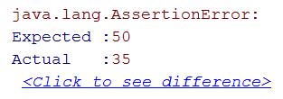
Assertions
assertTrue() vs assertEquals()
assertTrue()
assertEquals(expected, actual)
Assert.assertTrue(account.getBalance() == 50);
Assert.assertEquals(50, account.getBalance());
Better description when expecting value

Slide 28
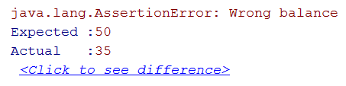
Assertion Messages
Assertions can show messages
Helps with diagnostics
Hamcrest is useful tool for test diagnostics
Assert.assertEquals(
"Wrong balance", 50, account.getBalance());
Helps finding the problem

Slide 29
Magic Numbers
Avoid using magic numbers (use constants instead)
private static final int AMOUNT = 50;
@Test
public void depositShouldAddMoney() {
BankAccount account = new BankAccount();
account.deposit(AMOUNT);
Assert.assertEquals("Wrong balance",
AMOUNT, account.getBalance());
}

Slide 30
@Before
Use @Before annotation
private BankAccount account;
@Before
public void createAccount() {
this.account = new BankAccount();
}
@Test
public void depositShouldAddMoney() { … }
Executes before each test

Slide 31


Naming Test Methods
Test names
Should use business domain terminology
Should be descriptive and readable
incrementNumber() {}
test1() {}
testTransfer() {}
depositAddsMoneyToBalance() {}
depositNegativeShouldNotAddMoney() {}
transferSubtractsFromSourceAddsToDestAccount() {}

Slide 32
Problem: Refactor Tests
Refactor the tests for Axe and Dummy classes
Make sure that:
Names of test methods are descriptive
You use appropriate assertions (assert equals vs assert true)
You use assertion messages
There are no magic numbers
There is no code duplication (Don’t Repeat Yourself)

Slide 33
Solution: Refactor Tests (1)
private static final int AXE_ATTACK = 10;
private static final int AXE_DURABILITY = 1;
private static final int DUMMY_HEALTH = 20;
private static final int DUMMY_XP = 10;
private Axe axe;
private Dummy dummy;
@Before
public void initializeTestObjects() {
this.axe = new Axe(AXE_ATTACK, AXE_DURABILITY);
this.dummy = new Dummy(DUMMY_HEALTH, DUMMY_XP); }

Slide 34
Solution: Refactor Tests (2)
@Test
public void weaponLosesDurabilityAfterAttack() {
this.axe.attack(this.dummy);
Assert.assertEquals("Wrong durability",
AXE_DURABILITY - 1,
axe.getDurabilityPoints()); }
@Test(expected = IllegalStateException.class)
public void brokenWeaponCantAttack() {
this.axe.attack(this.dummy);
this.axe.attack(this.dummy); }

Slide 35

Dependencies

Slide 36
Coupling and Testing (1)
Consider testing the following code:
We want to test a single behavior
Concrete Implementation
public class Bank {
private AccountManager accountManager;
public Bank() {
this.accountManager = new AccountManager();
}
public AccountInfo getInfo(String id) { … }
}
Bank depends on AccoutManager

Slide 37
Coupling and Testing (2)
Need to find solution to decouple classes
Interface
Bank inherits bugs
AccountManager
+Account getAccount()
Bank
AccountManager
uses
Bank

Slide 38
Dependency Injection
Decouples classes and makes code testable
Using Interface
interface AccountManager {
Account getAccount();
}
public class Bank {
private AccountManager accountManager;
public Bank(AccountManager accountManager) {
this.accountManager = accountManager;
}
}
Independent from Implementation
Injecting dependencies
38

Slide 39
Goal: Isolating Test Behavior
In other words, to fixate all moving parts
@Test
public void testGetInfoById() {
// Arrange
AccountManager manager = new AccountManager() {
public Account getAccount(String id) { … }
}
Bank bank = new Bank(manager);
AccountInfo info = bank.getInfo(ID);
// Assert… }
Anonymous class
Fake interface implementation with fixed behavior

Slide 40
Problem: Fake Axe and Dummy
Test if hero gains XP when target dies
To do this, first:
Make Hero class testable (use Dependency Injection)
Introduce Interfaces for Axe and Dummy
Interface Weapon
Interface Target
Create test using a fake Weapon and fake Dummy

Slide 41
Solution: Fake Axe and Dummy (1)
public interface Target {
void takeAttack(int attackPoints);
int getHealth();
int giveExperience();
boolean isDead();
}
public interface Weapon {
void attack(Target target);
int getAttackPoints();
int getDurabilityPoints(); }

Slide 42
Solution: Fake Axe and Dummy (2)
// Hero: Dependency Injection through constructor
public Hero(String name, Weapon weapon) {
this.name = name; /* Hero: Dependency Injection */
this.experience = 0; /* through constructor */
this.weapon = weapon; }
public class Axe implements Weapon {
public void attack(Target target) { … }
}
// Dummy: implement Target interface
public class Dummy implements Target { }

Slide 43
Solution: Fake Axe and Dummy (3)
@Test
public void heroGainsExperienceAfterAttackIfTargetDies() {
Target fakeTarget = new Target() {
public void takeAttack(int attackPoints) { }
public int getHealth() { return 0; }
public int giveExperience() { return TARGET_XP; }
public boolean isDead() { return true; }
};
// Continues on next slide…

Slide 44
Solution: Fake Axe and Dummy (4)
// …
Weapon fakeWeapon = new Weapon() {
public void attack(Target target) {}
public int getAttackPoints() { return WEAPON_ATTACK; }
public int getDurabilityPoints() { return 0; }
};
Hero hero = new Hero(HERO_NAME, fakeWeapon);
hero.attack(fakeTarget);
// Assert…
}

Slide 45
Fake Implementations
Not readable, cumbersome and boilerplate
@Test
public void testRequiresFakeImplementationOfBigInterface() {
// Arrange
Database db = new BankDatabase() {
// Too many methods…
};
AccountManager manager = new AccountManager(db);
// Act & Assert…
}
Not suitable for big interfaces

Slide 46

Mocking
Mock objects simulate behavior of real objects
Supplies data exclusively for the test - e.g. network data, random data, big data (database), etc.
@Test
public void testAlarmClockShouldRingInTheMorning() {
Time time = new Time();
AlarmClock clock = new AlarmClock(time);
if (time.isMorning()) {
Assert.assertTrue(clock.isRinging());
} }
Test will pass only in the morning!

Slide 47
Mockito
Mockito Web Site - Mockito 3.0.0 dependency
Copy dependency in pom.xml
<dependency>
<groupId>org.mockito</groupId>
<artifactId>mockito-core</artifactId>
<version>3.0.0</version>
<scope>test</scope>
</dependency>

Slide 48
Mockito
Framework for mocking objects
@Test
public void testAlarmClockShouldRingInTheMourning() {
Time mockedTime = Mockito.mock(Time.class);
Mockito.when(mockedTime.isMorning()).thenReturn(true);
AlarmClock clock = new AlarmClock(mockedTime);
if (mockedTime.isMorning()) {
Assert.assertTrue(clock.isRinging());
}
}
Always true

Slide 49
Problem: Mocking
Include Mockito in the project dependencies
Mock fakes from previous problem
Implement Hero Inventory, holding unequipped weapons
method - Iterable<Weapon> getInventory()
Implement Target giving random weapon upon death
field - private List<Weapon> possibleLoot
Test Hero killing a target getting loot in his inventory
Test Target drops random loot

Slide 50
Solution: Mocking (1)
@Test
public void attackGainsExperienceIfTargetIsDead() {
Weapon weaponMock = Mockito.mock(Weapon.class);
Target targetMock = Mockito.mock(Target.class);
Mockito.when(targetMock.isDead()).thenReturn(true);
Mockito.when(targetMock.giveExperience()).thenReturn(TARGET_XP);
Hero hero = new Hero(HERO_NAME, weaponMock);
hero.attack(targetMock);
Assert.assertEquals("Wrong experience", TARGET_XP,
hero.getExperience());
}

Slide 51
Solution: Mocking (2)
Create RandomProvider Interface
Hero method
attack(Target target, RandomProvider rnd)
Target method
dropLoot(RandomProvider rnd)
Mock weapon, target and random provider for test

Slide 52

Summary
Unit Testing helps us build solid code
Structure your unit tests – 3A Pattern
Use descriptive names for your tests
Use different assertions depending on the situation
Dependency Injection
makes your classes testable
Looses coupling and improves design
Mock objects to isolate tested behavior
…
…
…
What is Reflection
Reflection API
Reflecting Classes
Reflecting Constructors
Reflecting Fields
Reflecting Methods
Access Modifiers
Annotations are used to describe our code
Annotations provide the possibility to work with non-existing classes
Some annotations can be accessed through reflection

Slide 53
Questions?
Notes:
53

Slide 54











SoftUni Diamond Partners

Slide 55



Educational Partners

Slide 56
Trainings @ Software University (SoftUni)
Software University – High-Quality Education, Profession and Job for Software Developers
softuni.bg
Software University Foundation
softuni.foundation
Software University @ Facebook
facebook.com/SoftwareUniversity
Software University Forums
forum.softuni.bg
56
Notes:
56

Slide 57

License
This course (slides, examples, demos, exercises, homework, documents, videos and other assets) is copyrighted content
Unauthorized copy, reproduction or use is illegal
© SoftUni – https://about.softuni.bg
© Software University – https://softuni.bg
Notes:
57

